Slide 1









A typical Machine Learning cycle
TESTING
Today I will introduce you to the inner parts of this process
How to feed data into/interpret data from an ML model
What is an ML model made up of
How do ML algos find good models
Self-discipline every ML expert must observe
TEST DATA
TRAINING
Code
Code
ML Algorithm
Written by a human ML expert
ML model
Produced automatically by the ML algo
TRAINING DATA
The ML way to solve an ill-understood task

Slide 2
building blocks
Rome could not be built in a day, but HuggingFace allows certain ml models to be built in a day …

Slide 3




Communicating with the ML model
1000001011010010100001000001101110110111101111010000101010100110110101101101000010111110000110110101
Model
Features
Even though I look super cute, I am still a machine.
The model will itself output a bunch of numbers which we must then interpret as our class/label/score
We must describe our data point to an ML model (e.g. users, license plates, sentences, etc) as a bunch of numbers.
RECOMMENDATION

Slide 4


Melbo’s mother tongue
Vectors
An ordered list of numbers
Matrices
An ordered rectangular array of numbers
$$≠$$
1.0
-1.5
2.0
-2.5
0.0
2.0
1.0
0.0
-1.5
-2.5
1.0
4.0
-3.0
1.5
0.5
-7.0
6.0
6.0
-1.5
-2.5
-2.0
1.0
0.0
5.5
2.5
$$≠$$
-2.0
1.0
0.0
5.5
2.5
8.6
1.0
-9.3
-1.5
-2.5
8.6
1.0
-9.3
-1.5
-2.5
-7.0
6.0
6.0
-1.5
-2.5
1.0
4.0
-3.0
1.5
0.5

Slide 5





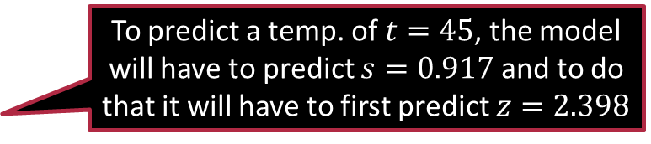
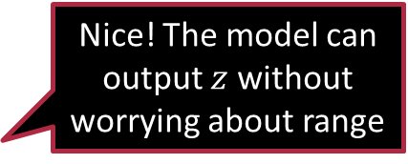




Interpreting Model Outputs – Regression
Nice! The model can output $z$ without worrying about range
$$t$$
Suppose we wish to predict the temperature tomorrow
Would want the model to give scores between $[−10, 50]$
Solution: ask for scores in $\left[0,1\right]$ then scale-and-shift
$t↦\left(50−\left(−10\right)\right)×s−10=60×s−10$
$s=σ\left(z\right)=\frac{1}{1+\exp\left(−z\right)}$
50
0
-10
$$s$$
0
1
SIGMOID
$$s$$
To predict a temp. of $t=45$, the model will have to predict $s=0.917$ and to do that it will have to first predict $z=2.398$
1
How to ask the model to predict scores in $\left[0,1\right]$ ?
Sigmoid is an example of an activation or squashing function
0.5
$$z$$
0
-5 -4 -3 -2 -1 0 1 2 3 4 5

Slide 6

Exercise
Say we want the ML model to output $t=−9.8$ as the temp. What initial value $z$ must be predicted by the model to enable this and what would be the intermediate $s$ value?
The sigmoid function grows rather slowly. Suppose we wish to make it transition between $0$ and $1$ sharper. How would you modify the sigmoid function to do this?
Hint: Exploring $σ_{t}\left(z\right)=1/\left(1+\exp\left(−t⋅z\right)\right)$for different values of $t$

Slide 7












Interpreting Model Outputs – Classification
Binary Classification
Multi-class Classification
Multi-label Classification
$$1$$
NON-SPAM = $0$
SPAM = $1$
$$−1$$
Often called a “one-hot” vector
How does a model output a one-hot vector?
$$0$$
$$−1$$
Model
There are other activation functions to help do this. We will study these later
0
0
0
0
1
0
1
0
0
0
A “many-hot” vector
Primary Social Promotions Updates Forums
0
0
0
0
0
0
0
1
0
1
1
0
Entertainment Work Friends Money Urgent Family

Slide 8










Fantastic Features (and how to find them)
23
AGE
99.2
PATIENT 11
Numerical Features
Represented using their numerical value
Categorical Features
Represented as a one hot vector
Relational Features
Often as a many-hot vector
0
1
0
0
1
0
0
Male Female Other
BTECH MTECH MS PHD
Inputs to the ML model seem to be represented in the same way the outputs are … just a coincidence?
0 | 0 | 0 | 1 | 1 | 0 | 0
0 | 0 | 0 | 1 | 0 | 0 | 1
0 | 0 | 0 | 0 | 0 | 1 | 0
1 | 1 | 0 | 0 | 1 | 0 | 0
1 | 0 | 0 | 1 | 0 | 1 | 1
0 | 0 | 1 | 0 | 1 | 0 | 0
0 | 1 | 0 | 0 | 1 | 0 | 0
Not at all! Isn’t what we are trying to predict about a data point, also in some sense a descriptor for it?

Slide 9
Derived Features
ESC101 (A), ESO207 (B), CS220 (B), CS340 (C), MSO201 (A), CS771 (A)
Bagged/binned features
Pooled/aggregated features
Called a “bag-of-words” representation
A B C D E F
apple | day | below | every | find | her | how | plant | power | water | went
0 | 1 | 0 | 2 | 0 | 0 | 0 | 1 | 0 | 1 | 0
0 | 0 | 0 | 0 | 0 | 0 | 0 | 1 | 1 | 0 | 1
0 | 0 | 0 | 0 | 1 | 0 | 2 | 0 | 0 | 0 | 0
@
Every day I water every plant
@
I went to the power plant today
@
How to find out how to learn
4
FRIENDS
1 | 0 | 0 | 1 | 0 | 1 | 1
The ML expert is free to choose whichever features they feel are best suited to solve their task
ESC101 (A), ESO207 (B), CS220 (B), CS340 (C), MSO201 (A), CS771 (A)
10 (max), 8.67 (avg)

Slide 10
Exercise
Recall the daily activity A2 you had thought of (refer to the video “Getting Started”) for which it was difficult for you to specify a step-by-step procedure to solve it. Think of what features would be helpful in solving the problem, how would you feed them into the model, and how would you ask the model to give output so that it can be interpreted by you

Slide 11










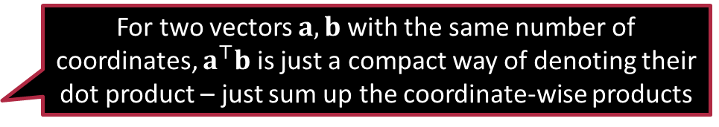
Find my salary!
For two vectors $a,b$ with the same number of coordinates, $a^{⊤}b$ is just a compact way of denoting their dot product – just sum up the coordinate-wise products
Age | Highest education (HS, BT, MT, PhD) |  |  |  | Gender (M, F, O) |  |  | True Salary
$$x_{1}$$ | $$x_{2}$$ | $$x_{3}$$ | $$x_{4}$$ | $$x_{5}$$ | $$x_{6}$$ | $$x_{7}$$ | $$x_{8}$$ | $$y$$
45 | 0 | 0 | 1 | 0 | 1 | 0 | 0 | 64475
22 | 0 | 1 | 0 | 0 | 0 | 1 | 0 | 34179
28 | 1 | 0 | 0 | 0 | 1 | 0 | 0 | 34573
34 | 0 | 0 | 1 | 0 | 0 | 1 | 0 | 50882
47 | 1 | 0 | 0 | 0 | 0 | 1 | 0 | 38660
55 | 0 | 0 | 1 | 0 | 1 | 0 | 0 | 71487
49 | 0 | 0 | 0 | 1 | 0 | 1 | 0 | 79430
27 | 0 | 1 | 0 | 0 | 0 | 0 | 1 | 34355
25 | 0 | 1 | 0 | 0 | 1 | 0 | 0 | 43837
We suspect salary rises with age, with education and is influenced by gender
Don’t know by how much though
Let us conjecture the following laws
Everyone starts with a base salary $b$ (minimum wage)
Salary goes up by $d$ for every additional year of age
Salary further goes up by $p,q,r,s$ resp. if someone has education up to HS, BT, MT, PhD
Males, Females, Others get $k,l,m$ additional salary resp.
$\hat{y}=b+d⋅x_{1}+p⋅x_{2}+q⋅x_{3}+r⋅x_{4}+s⋅x_{5}+k⋅x_{6}+l⋅x_{7}+m⋅x_{8}$
Can be compactly written as $\hat{y}=b+w^{⊤}x$
$x=\left[x_{1},x_{2},x_{3},x_{4},x_{5},x_{6},x_{7},x_{8}\right]$
$w=\left[d,p,q,r,s,k,l,m\right]$

Slide 12
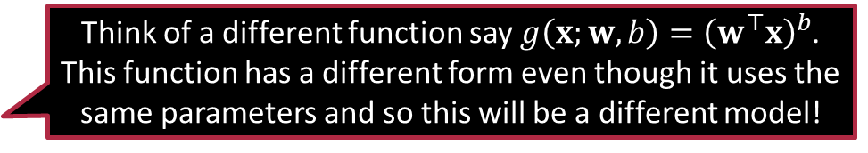

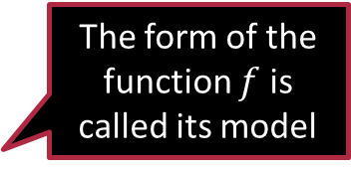
A brief anatomy of an ML model
The form of the function $f$ is called its model
But what exactly is the “model” here?
$\hat{y}=b+w^{⊤}x$
Visualize this as a function taking in a data point giving an output $\hat{y}=f\left(x ;w,b\right)$
ML models have some unknowns called parameters of the model
This linear model has one vector parameter $w$ and one scalar parameter $b$
The goal of ML algos is to discover parameter values so that when using those parameter values inside the model, the predicted outputs of the models match the true ones
Think of a different function say $g\left(x;w,b\right)={\left(w^{⊤}x\right)}^{b}$. This function has a different form even though it uses the same parameters and so this will be a different model!
This is what we call a linear model in ML literature

Slide 13



A look at how ML algos work!
I have 9 users in my training set. Each one of them might have a different mismatch. Which one should I use?
Right … there might be param values that predict salaries for just one user correctly and do horribly on other users. We need to do well on all users.
ML algos need to find which param values are good and which aren’t
Straightforward way: call a given set of param values “good” if predictions obtained using those param values match the true outputs
Need to make this mathematical: common to use a “loss function” for this
Let the feature vector of the $i$-th user be $x^{i}$, their true salary be $y^{i}$ and their predicted salary be ${\hat{y}}^{i}$
Can measure mismatch between true and predicted salary as $ℓ_{i}=\left|{\hat{y}}^{i}−y^{i}\right|$
Other choices could have been simply $ℓ_{i}={\left({\hat{y}}^{i}−y^{i}\right)}^{2}$
The first choice is the “absolute loss” and the second is “least squares loss”
It is usually risky to rely on a single user to decide whether a given set of parameter values is good or not. Better take the average loss across all training users.

Slide 14

A look at how ML algos work!
A beautiful duality: data points and params operate on each other ☺
ML model: gives prediction ${\hat{y}}^{i}$ on a data point $x^{i}$ using param values $θ$
${\hat{y}}^{i}=f\left(x^{i};θ\right)$
Loss function: gives loss value $ℓ_{i}$ for params $θ$ using data point $\left(x^{i},y^{i}\right)$ $ℓ_{i}=ℓ\left(θ;x^{i},y^{i}\right)$
Often, loss value is computed using predicted and true outputs $ℓ_{i}=ℓ\left({\hat{y}}^{i},y^{i}\right)=ℓ\left(f\left(x^{i};θ\right),y^{i}\right)$
Almost always, average loss value over entire training set used to train $ℓ\left(θ\right)≝\frac{1}{n}\sum_{i=1}^{n}{ℓ\left(θ;x^{i},y^{i}\right)}$

Slide 15



A look at how ML algos work!
Age | Highest education (HS, BT, MT, PhD) |  |  |  | Gender (M, F, O) |  |  | True Salary
$$x_{1}$$ | $$x_{2}$$ | $$x_{3}$$ | $$x_{4}$$ | $$x_{5}$$ | $$x_{6}$$ | $$x_{7}$$ | $$x_{8}$$ | $$y$$
45 | 0 | 0 | 1 | 0 | 1 | 0 | 0 | 64475
22 | 0 | 1 | 0 | 0 | 0 | 1 | 0 | 34179
28 | 1 | 0 | 0 | 0 | 1 | 0 | 0 | 34573
34 | 0 | 0 | 1 | 0 | 0 | 1 | 0 | 50882
47 | 1 | 0 | 0 | 0 | 0 | 1 | 0 | 38660
55 | 0 | 0 | 1 | 0 | 1 | 0 | 0 | 71487
49 | 0 | 0 | 0 | 1 | 0 | 1 | 0 | 79430
27 | 0 | 1 | 0 | 0 | 0 | 0 | 1 | 34355
25 | 0 | 1 | 0 | 0 | 1 | 0 | 0 | 43837
Predicted | Loss
$$\hat{y}$$ | $$ℓ_{i}$$
50208 | 14267
50208 | 16029
50208 | 15635
50208 | 674
50208 | 11548
50208 | 21279
50208 | 29222
50208 | 15853
50208 | 6371
Attempt 1: $w=0,b=50208$
Avg absolute loss: 14542
You are useless Melbo!
But I am still trying!
Okay Melbo! Time to shape up

Slide 16



A look at how ML algos work!
Age | Highest education (HS, BT, MT, PhD) |  |  |  | Gender (M, F, O) |  |  | True Salary
$$x_{1}$$ | $$x_{2}$$ | $$x_{3}$$ | $$x_{4}$$ | $$x_{5}$$ | $$x_{6}$$ | $$x_{7}$$ | $$x_{8}$$ | $$y$$
45 | 0 | 0 | 1 | 0 | 1 | 0 | 0 | 64475
22 | 0 | 1 | 0 | 0 | 0 | 1 | 0 | 34179
28 | 1 | 0 | 0 | 0 | 1 | 0 | 0 | 34573
34 | 0 | 0 | 1 | 0 | 0 | 1 | 0 | 50882
47 | 1 | 0 | 0 | 0 | 0 | 1 | 0 | 38660
55 | 0 | 0 | 1 | 0 | 1 | 0 | 0 | 71487
49 | 0 | 0 | 0 | 1 | 0 | 1 | 0 | 79430
27 | 0 | 1 | 0 | 0 | 0 | 0 | 1 | 34355
25 | 0 | 1 | 0 | 0 | 1 | 0 | 0 | 43837
Predicted Salary | Loss
$$\hat{y}$$ | $$ℓ_{i}$$
65000 | 525
33200 | 979
34800 | 227
50400 | 482
38200 | 460
71000 | 487
79400 | 30
34200 | 155
43000 | 837
Attempt 2: $w=[600, 0, 10000,$ $20000, 40000,$ $10000, 2000, 0]$ $b=8000$
Avg. absolute loss: 465
You are amazing Melbo!
We will soon learn algos that minimize loss

Slide 17




A typical Exam Preparation cycle
TESTING
TEST
TEST
TEST
TRAINING
MCQ
MCQ
MCQ
Subject Knowledge
Preparation
MCQ
MCQ
PRACTICE TESTS
CORRECT / INCORRECT
CORRECT / INCORRECT
CORRECT / INCORRECT
The old-fashioned way to prepare for an exam

Slide 18
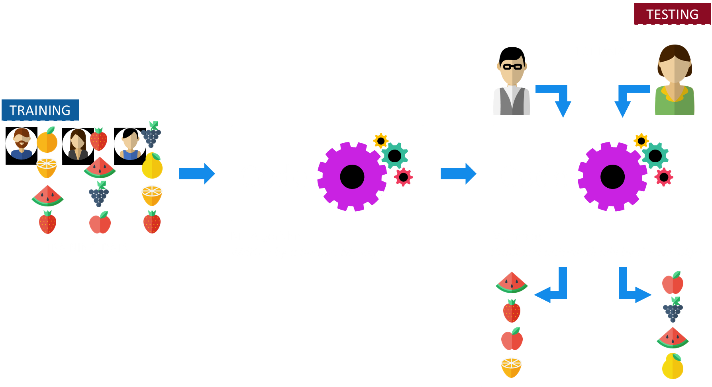
A typical Machine Learning cycle
The ML way to solve an ill-understood task

Slide 19
ML as an Examination
Our brain stores subject matter
Use subject matter to solve exam
Critical to do well on exam-day
Practice test results indicative
No out-of-syllabus questions
Should not leak exam paper
The model stores laws/ patterns
Use model to predict on test data
Critical to do well on test data
Training performance indicative
Training/test data are similar
Never see test data while training

Slide 20
Essential self-discipline for ML experts
Never look at test data during model training
Can give misleadingly good results for a model that is not so good
E.g., easy to do very well on JEE, GATE if someone has leaked the exam paper
Model performance may look drop once more test data comes
However, that person may struggle at course/thesis work after admissions
Evaluate model’s test performance once done with training
This will provide an impartial, trustworthy estimate of the model’s power
What about online learning? Didn’t you tell us that train and test data gets all mixed up there?
Not quite … in online learning, a data point becomes a part of training data only after we have tested on it

Slide 21
Summary
Descriptions of data points should be provided to the model in the form of features which may be numerical, categorical, relational etc.
It is possible to take features and derive other summarized features
The model outputs can be in the form of numerical values and one/many-hot vectors must be interpreted as per the application
It is possible to use activation and shift-n-scale operations on the outputs
ML models take data points as inputs and use parameters to make predictions
ML algos use loss functions to search for good parameter values
It is important to never use test data in any form during training

Slide 22
Stay Wonderful!
Catch-up with you in the next one

